Slide 1
Project-X Status Report
Generated by agilemontecarlo.com

Slide 2
Context This report is generated by agilemontecarlo.com
Present in sprint demos or steering meetings to drive visibility
Data is easily imported directly from Jira or added manually
Simulate scope and velocity changes and see impact
Multiple simulation and chart configurations
Issue count or story points
Historical sample or normal output distribution
…

Slide 3
S-Curve Project Tracking Draw the project S-Curve and get a estimated landing zone if the output is below the curve

Slide 4
Monte Carlo Project Tracking Track the project against a target date with a target scope

Slide 5
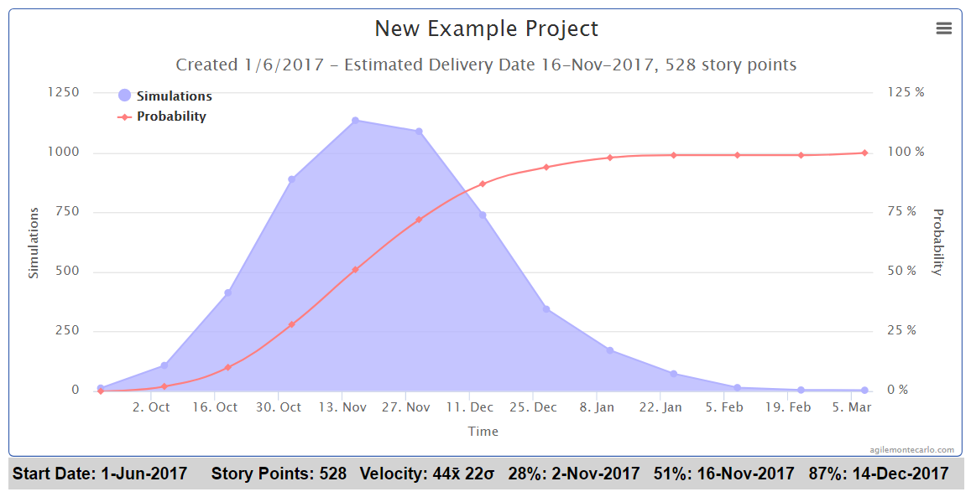
Project Monte Carlo Forecast Show the outcome of 5000 project simulations to stakeholders

Slide 6
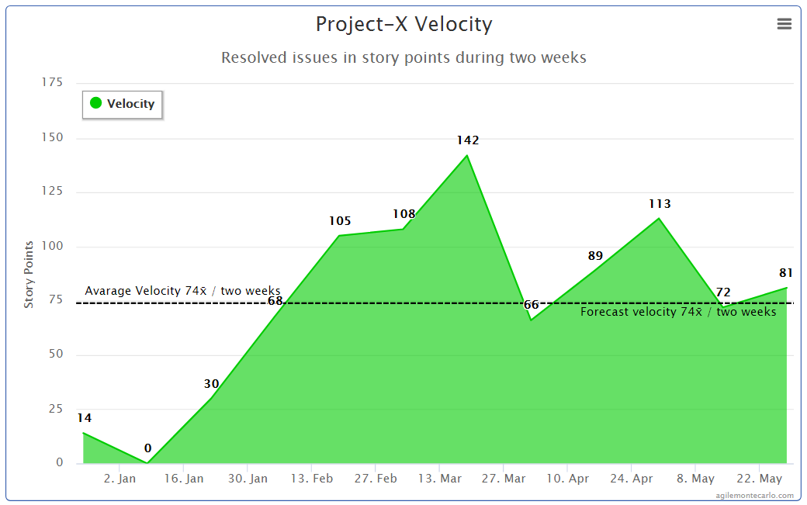
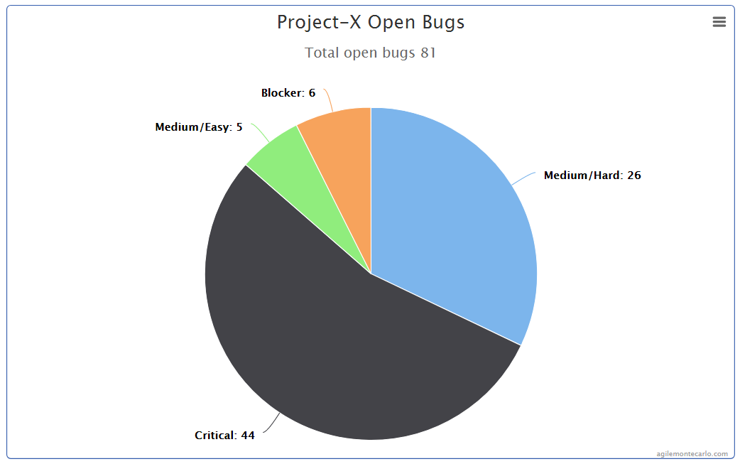
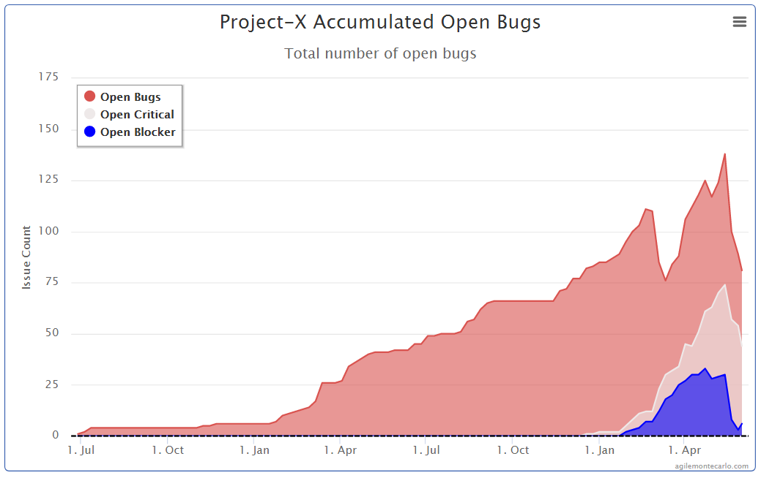
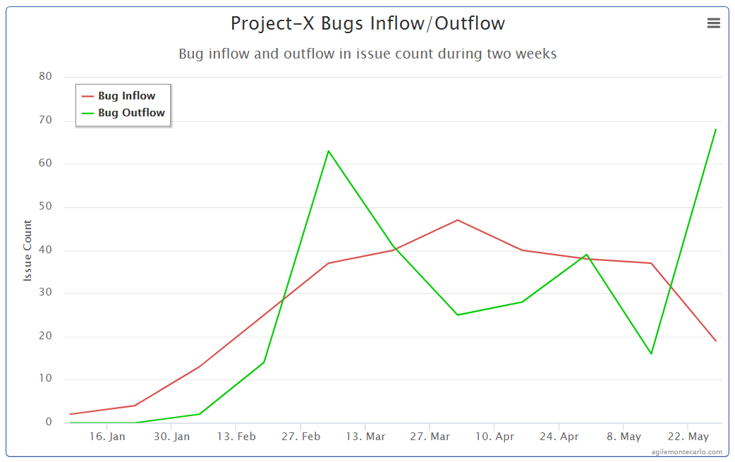

Slide 7
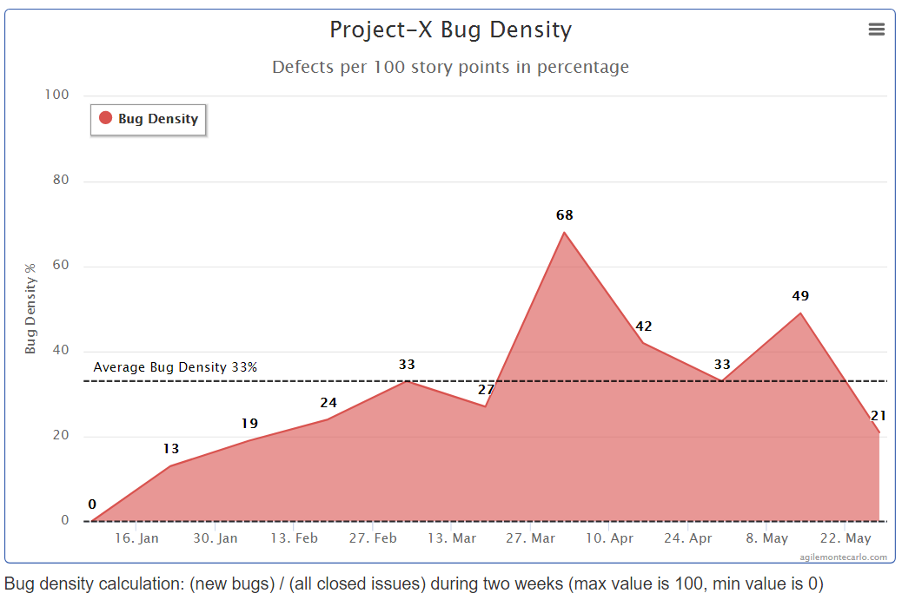
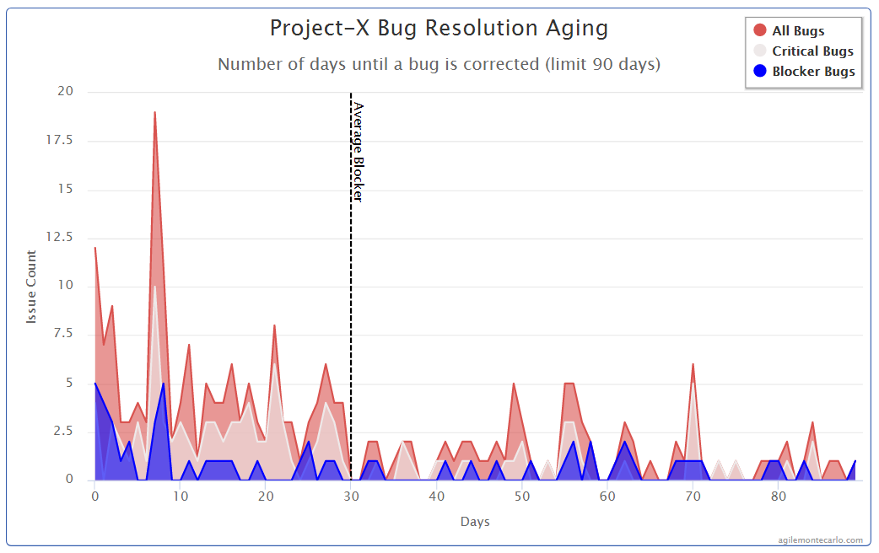

Slide 8
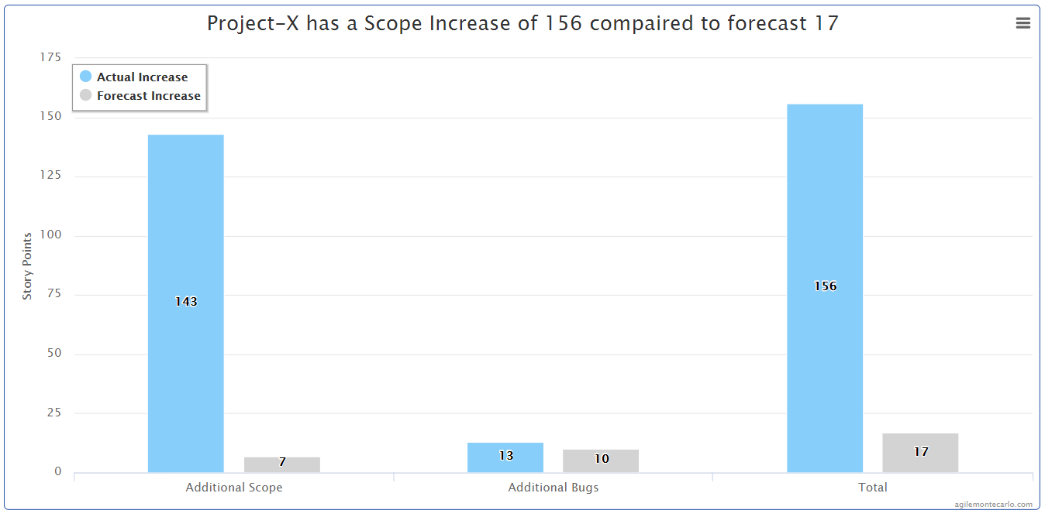
Project-X Scope Increase Overview

Slide 9
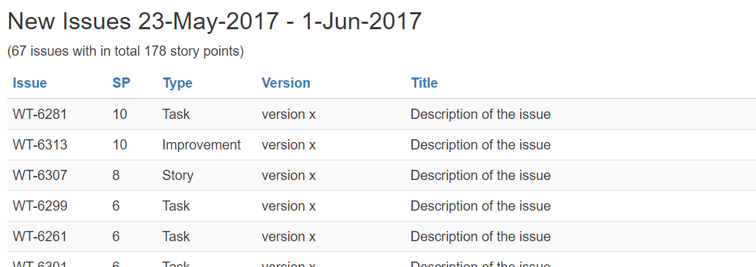
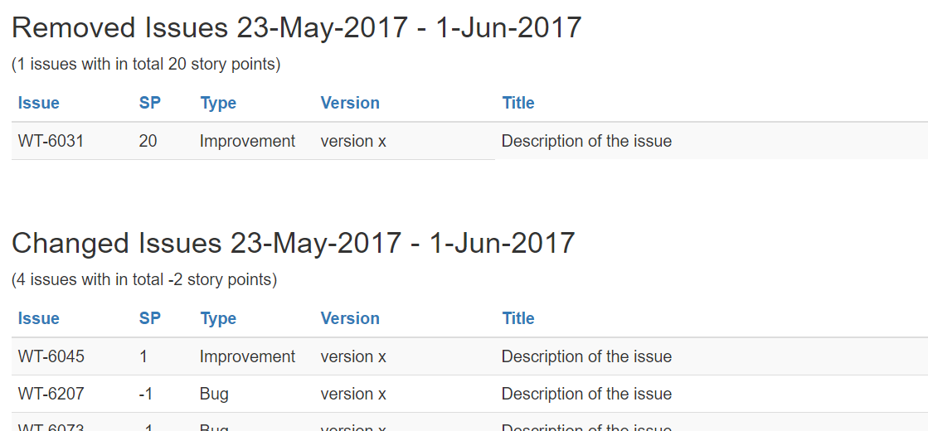
Project-X Scope Increase Details

